Slide 1
Bank management system

Slide 2
Submitted in partial fulfilment of the requirements of the degree of BACHELOR’S of TECHNOLOGY
Submitted By:
Akshat Audichya (Roll no.: 20ETCCS005)
Kanishk Asawara (Roll no.: 20ETCCS059)

Slide 3
COMPUTER SCIENCE DEPARTMENT TECHNO INDIA NJR INSTITUTE OF TECHNOLOGY, UDAIPUR MAY 2024

Slide 4
PROBLEM STATEMENT
Many banks, especially smaller institutions, rely on outdated or siloed systems for managing accounts, transactions, and customer data. These systems often lack integration, leading to inefficiencies, manual data entry, and errors. Additionally, traditional systems might not offer robust reporting or analytics capabilities, making it difficult for banks to gain insights into customer behaviour and trends.

Slide 5
OBJECTIVE OF PROJECT
The objective of this project is to develop and implement a comprehensive Bank Management System (BMS) using SAP to address the limitations of existing systems and achieve the following:
Increased Efficiency and Accuracy: Automate core banking functions and workflows to reduce manual processes and errors.
Enhanced Reporting and Analytics: Provide robust reporting tools to generate valuable customer data insights and support informed decision-making.
Improved Customer Service: Deliver faster and more accurate account management and transactions for a better customer experience.
Reduced Operational Costs: Streamline operations through automation and integration, leading to reduced resource needs.
Ensured Regulatory Compliance: Adhere to current banking regulations and standards to mitigate risk.

Slide 6
SCOPE OF PROJECT
This project will encompass the development and implementation of the following functionalities within the SAP-based BMS:
Core Banking Functions: Integrate account management, transactions (deposits, withdrawals, transfers), loan processing, and deposit management functionalities.
Customer Management: Facilitate customer account creation, profile management, and interaction tracking.
Reporting and Analytics: Develop tools to generate reports on customer activity, financial performance, and risk management.
Security and Compliance: Ensure data security and system access controls that comply with relevant banking regulations.

Slide 7
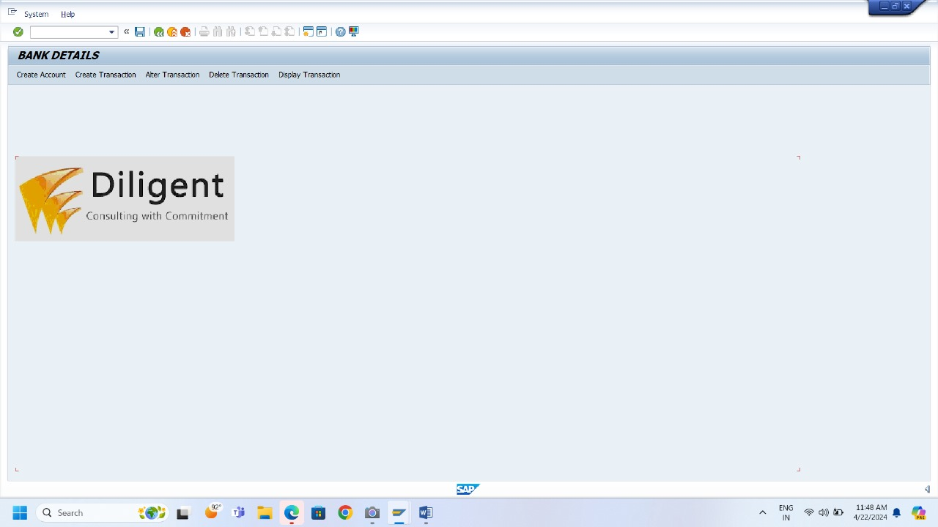
HOME PAGE:

Slide 8
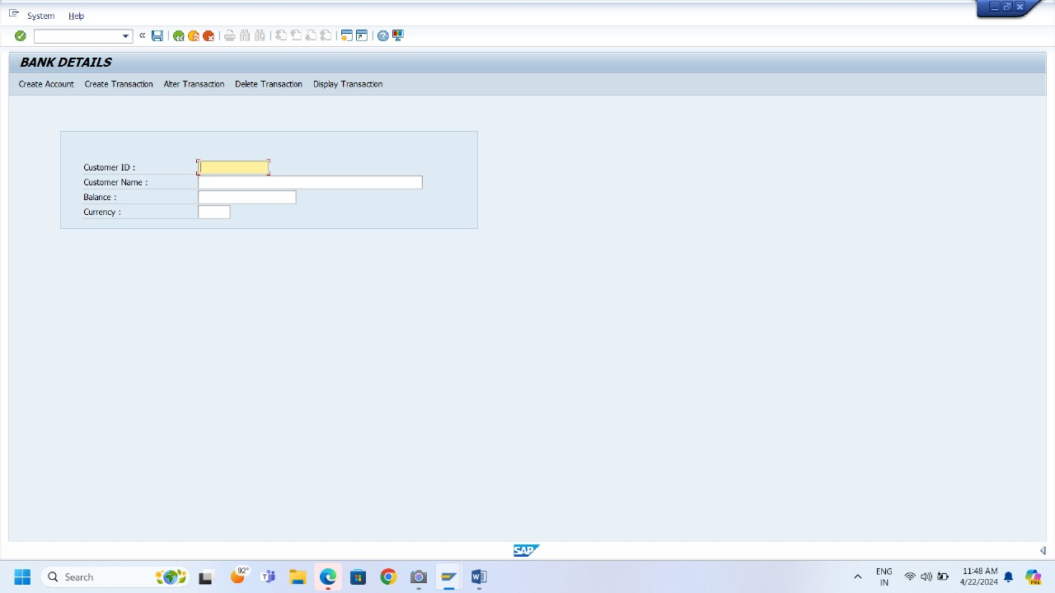
ACCOUNT CREATION PAGE:

Slide 9
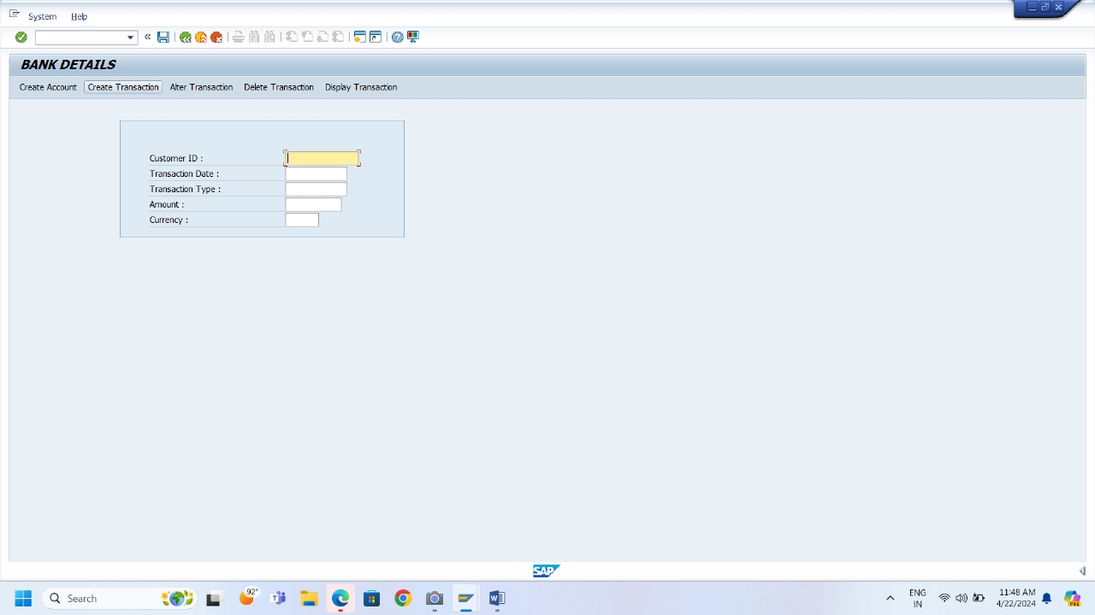
CREATE TRANSACTION PAGE:

Slide 10
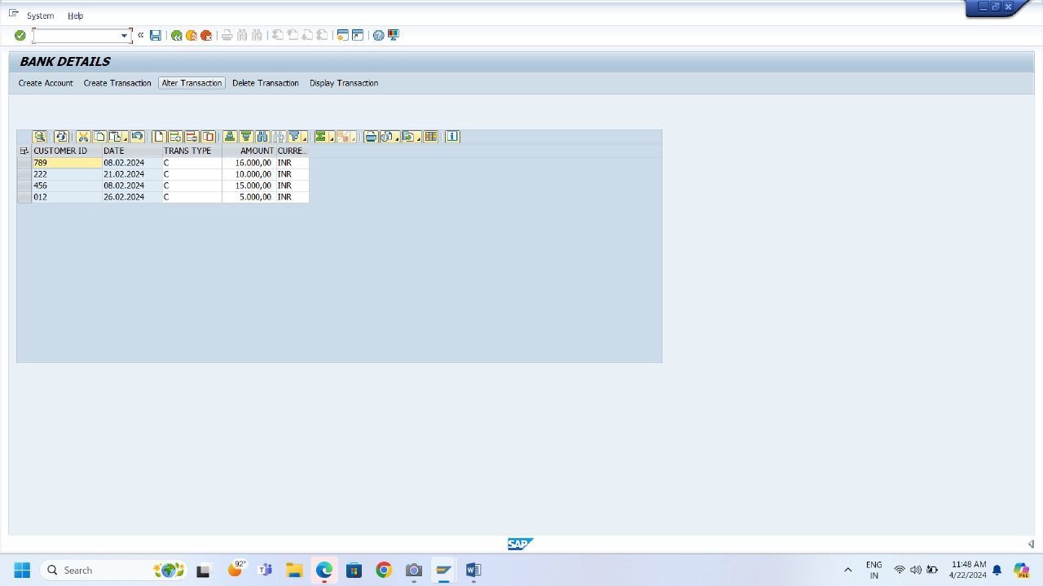
ALTER TRANSACTION PAGE:

Slide 11
FUTURE SCOPE OF PROJECT
Mobile and Online Banking Integration: Develop a mobile app and online banking portal that seamlessly integrates with the core BMS. This will allow customers to access accounts, conduct transactions, and manage finances conveniently.
Advanced Financial Products: Expand the system's functionality to handle more complex financial instruments, such as investment products, derivatives, or wealth management services.
AI and ML Integration: Incorporate AI and ML algorithms to personalize customer experiences, predict customer behavior, and identify potential fraud risks.
Big Data Analytics: Leverage big data capabilities within SAP to analyze vast amounts of customer data for deeper insights, improved risk management, and tailored product offerings.
Regulatory Reporting Automation: Automate the generation of regulatory reports to ensure compliance with evolving regulations and minimize manual effort.
Third-Party Integration: Expand the system's reach by integrating with external platforms for services like loan origination, credit scoring, or digital payment gateways.
Blockchain Technology Integration: Explore the potential of blockchain technology for secure and transparent record-keeping within the banking system.

Slide 12
PROJECT TIMELINE
WEEKS | PROCESS
WEEK 1 | PLANNING
WEEK 2 | DESIGNING OF ER DIAGRAM
WEEK 3 | CREATING AND CONNECTING TABLES
WEEK 4 | DEVELOPING USER INTERFACE
WEEK 5 | BACKEND DEVELOPMENT
WEEK 6 | TESTING AND DEBUGGING
WEEK 7 | DEPLOYMENT

Slide 13
BIBLIOGRAPHY
https://www.sapabap.com/
https://www.sap.com/india/industries/banking.html
https://www.geeksforgeeks.org/what-is-sap-abap-data-dictionary-ddic/
https://www.tutorialspoint.com/sap_abap/index.html

